Slide 1
A Unified Bayesian Framework for Jointly Inferring System Order
and Parameters of LTI State-Space Models
School of Power and Energy
Hongru Liu
2025/11

Slide 2

SGWRC 2025
Background
Methodology
Results
Discussion
Conclusion
CONTENTS

Slide 3
The First Section
Background

Slide 4
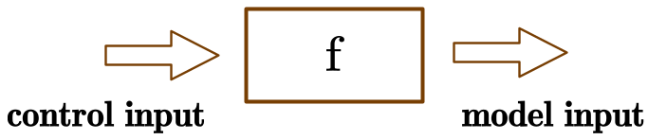

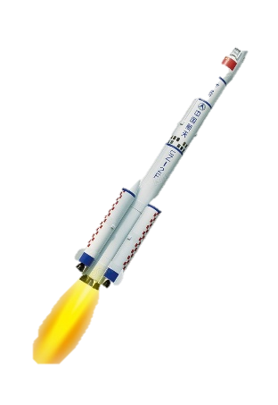
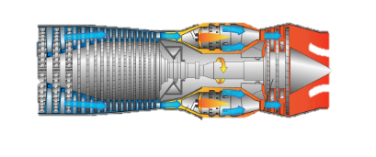
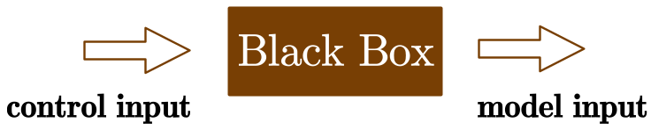
Background
Methodology
Results
Discussion
Conclusion
For all model-based control algorithms, like Pole Placement, LQR, MPC…, the explicit form of f must be known to determine control input.
If the model is difficult to established, like rockets, airplanes, jet engines.
One way is to identify the model’s transfer function or state-space representation.

Slide 5
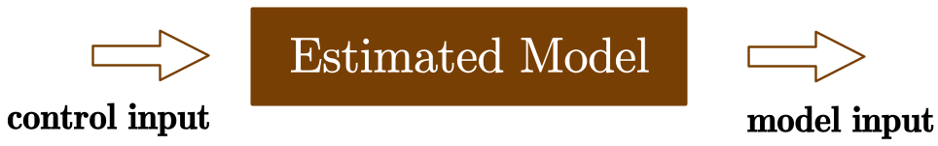
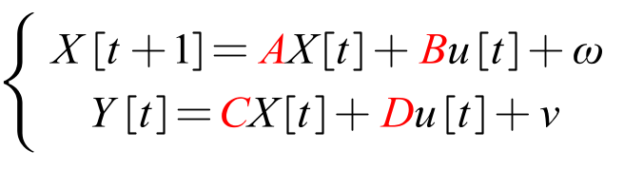
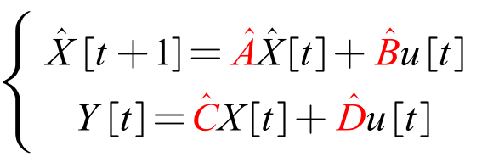
Background
Methodology
Results
Discussion
Conclusion
In a Bayesian perspective, parameters are treated as random variables. We infer their posterior probability distribution by combining the likelihood function with a prior distribution.
Bayesian Inference
A state-space representation with unknown parameters A, B, C, D
An estimate state-space representation

Slide 6

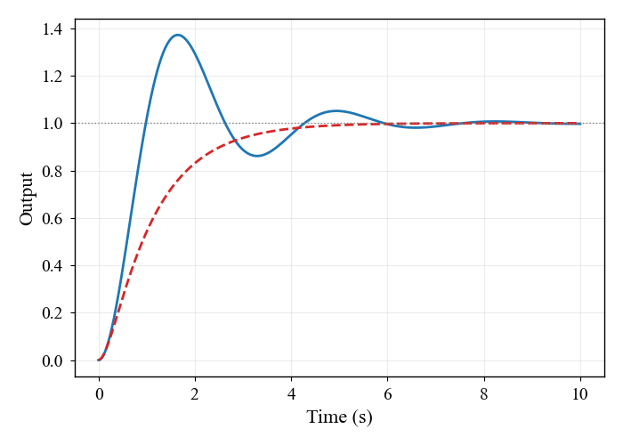
Background
Methodology
Results
Discussion
Conclusion
Canonical form
Current parameters to infer are:
Bryutkin, Andrey, et al. "Canonical bayesian linear system identification." (2025)
The order of system is often unknown.
While the prior uses lambda, it‘s A that is actually inferred, whose physical meaning is not obvious.
We used an RJ-MCMC framework to infer model order and model parameters at the same time. By performing a random walk directly on the ratio of real to complex roots, real and complex roots are identified separately.
Blue: complex eigenvalues
Red: real eigenvalues

Slide 7
The Second Section
Methodology

Slide 8
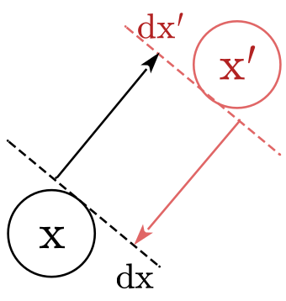
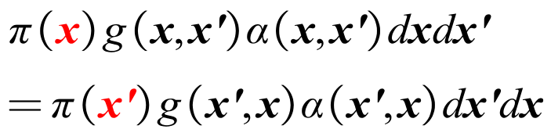
Background
Methodology
Results
Discussion
Conclusion
An Intuitive Grasp of Probability Transition
The detailed balance condition for a standard MCMC algorithm is defined on a fixed-measure space. It compares the transition densities between two points without involving a change of coordinates or a transformation of the underlying measure.
The detailed balance condition implies that the probability flux from state x to state x' equals the probability flux from x' to x.

Slide 9
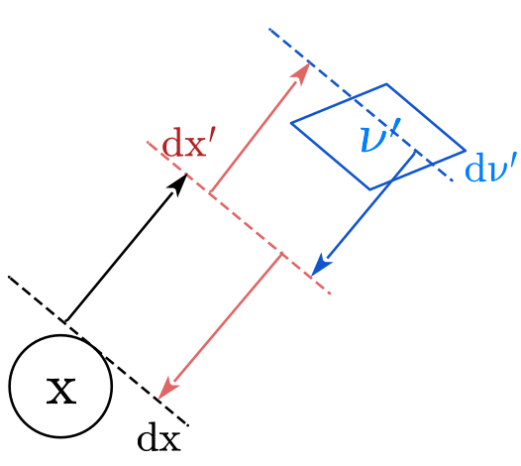
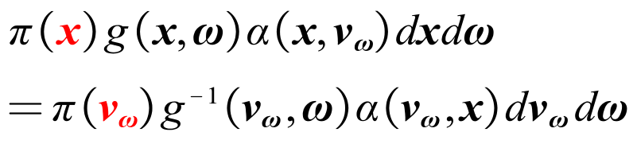
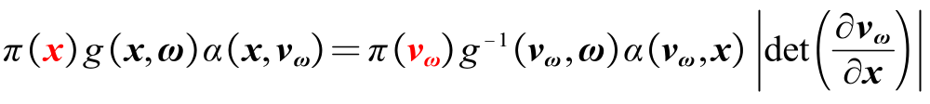
Background
Methodology
Results
Discussion
Conclusion
RJ-MCMC uses auxiliary variables to achieve "dimension matching" for moves between spaces. Since this mapping distorts the underlying measure the detailed balance must be corrected, ultimately introducing a Jacobian determinant into the acceptance rate.
The Jacobian term ensures the equality of probability flux in the detailed balance condition !

Slide 10
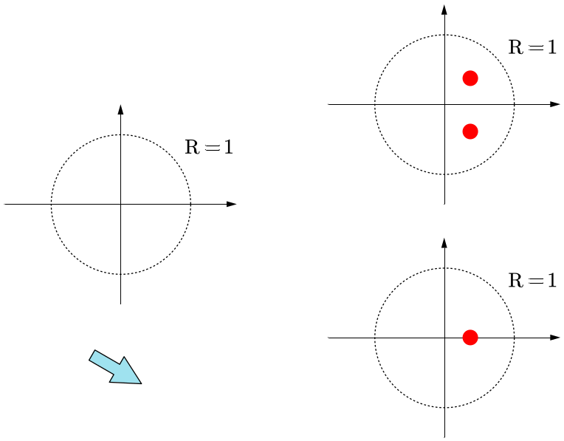
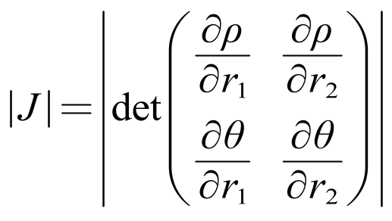
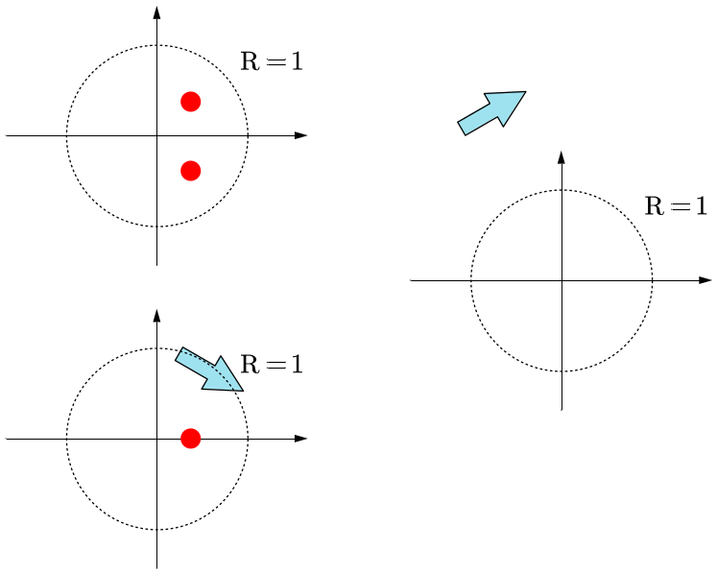
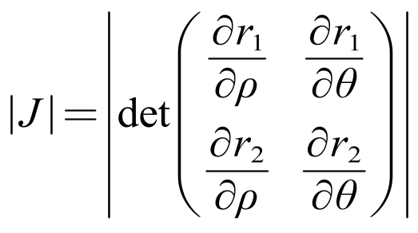
Background
Methodology
Results
Discussion
Conclusion
Birth
Death

Slide 11
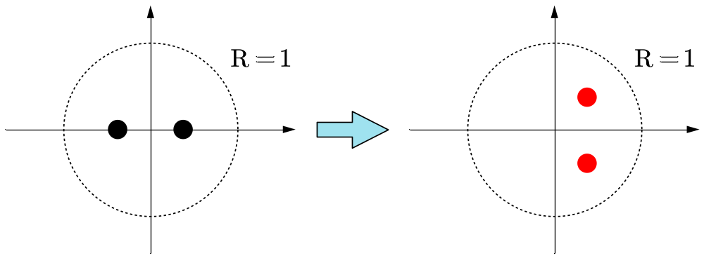
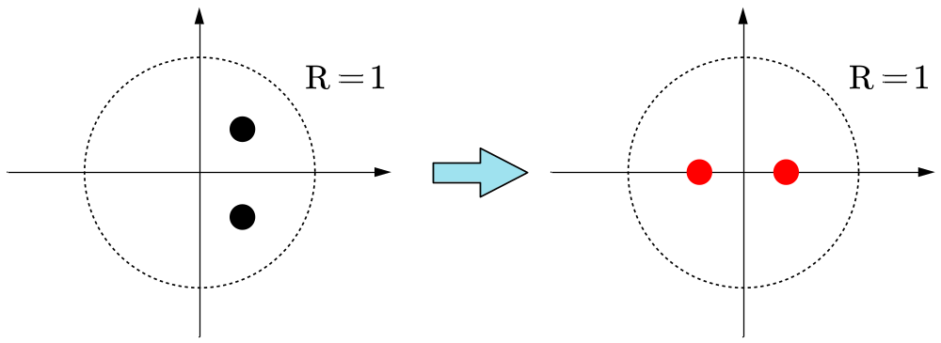
Background
Methodology
Results
Discussion
Conclusion
Split
Merge

Slide 12
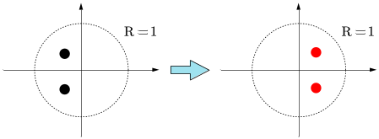
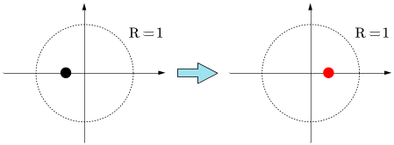
Background
Methodology
Results
Discussion
Conclusion
Five categories of random walks:
In the early stages of training, mainly focus on birth-death processes to infer the model order.
In the middle stages of training, mainly focus on split-merge processes to infer the root types.
In the final stages of training, mainly focus on random walking processes to infer the root locations.

Slide 13
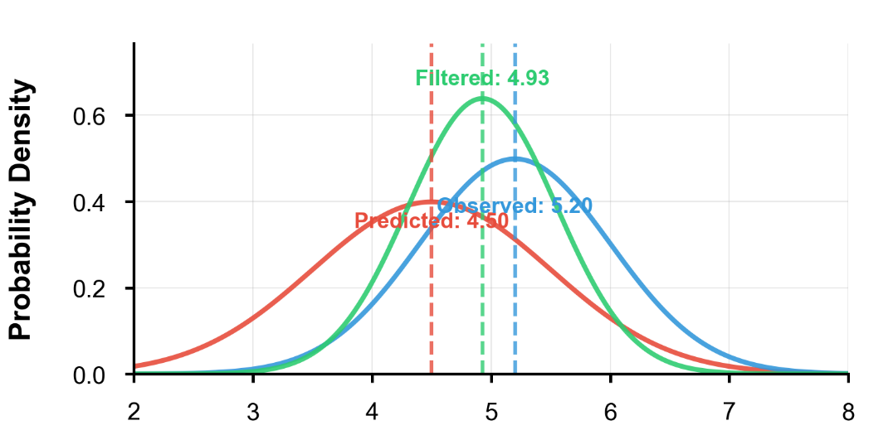
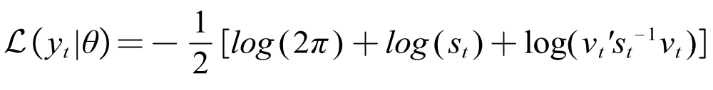
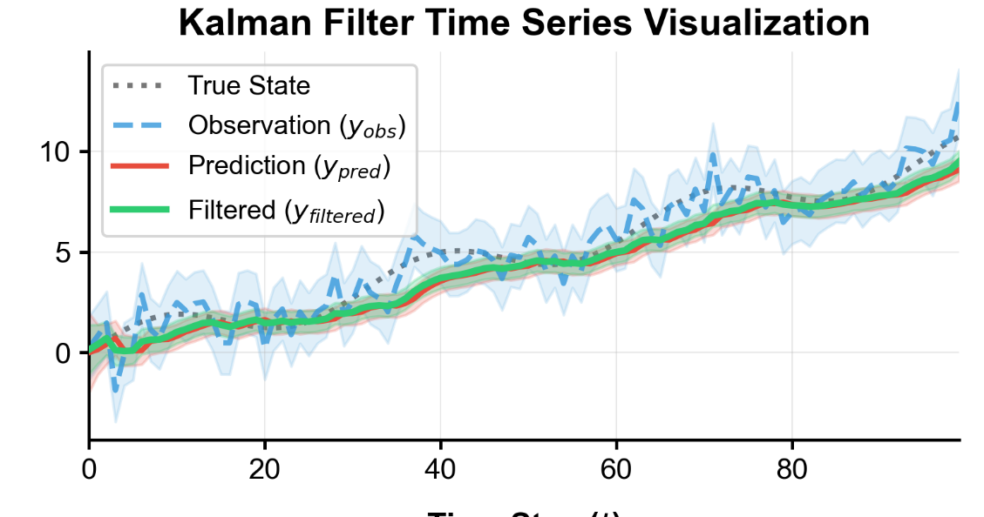
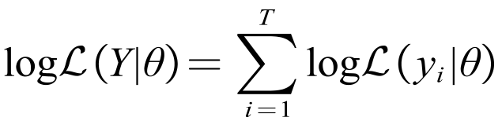
Background
Methodology
Results
Discussion
Conclusion
After the Kalman Filter Process:
At each time step:
The likelihood of the joint distribution over the complete simulation interval:

Slide 14
The Third Section
Results

Slide 15
Background
Methodology
Results
Discussion
Conclusion
Birth of real eigen values:
Birth of complex eigen values:
Death of real eigen values:
Real !
Death of complex eigen values:
Complex Pair !

Slide 16
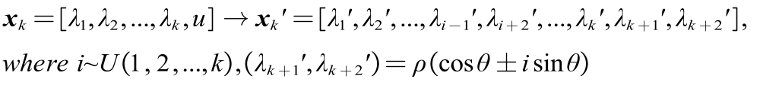
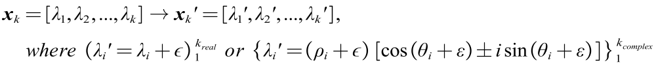
Background
Methodology
Results
Discussion
Conclusion
Merge of real eigen values:
Real !
Split of complex eigen values:
Complex Pair !
Random swim:
Complex Pair !
Real !

Slide 17



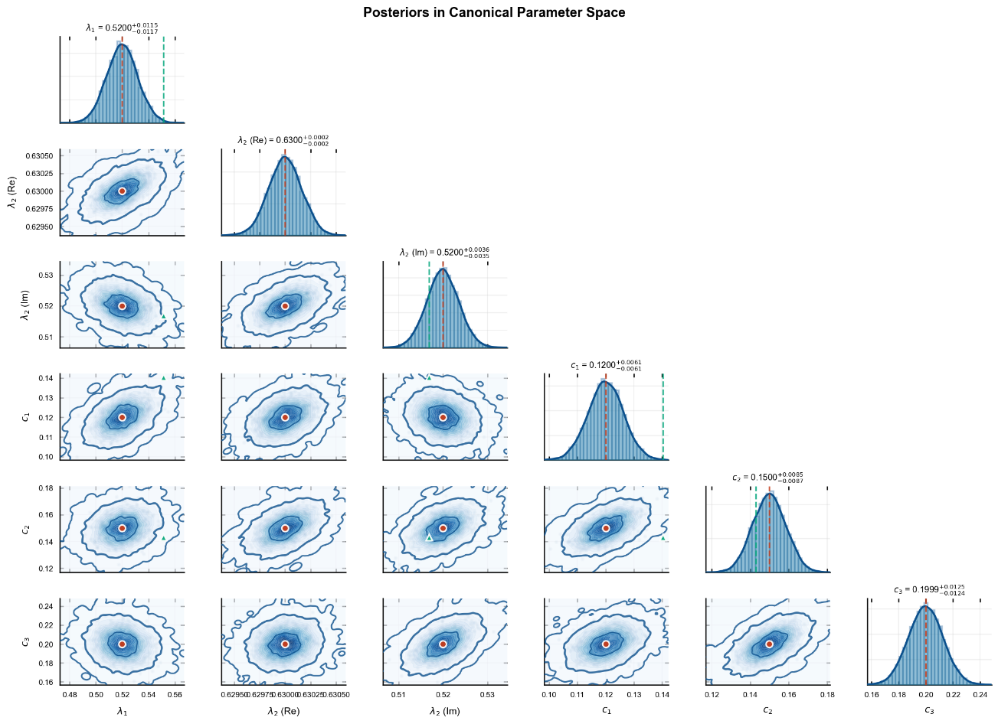



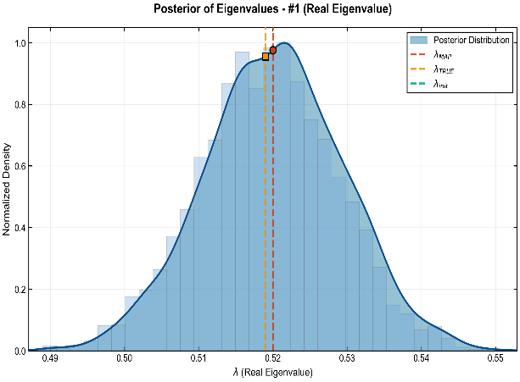
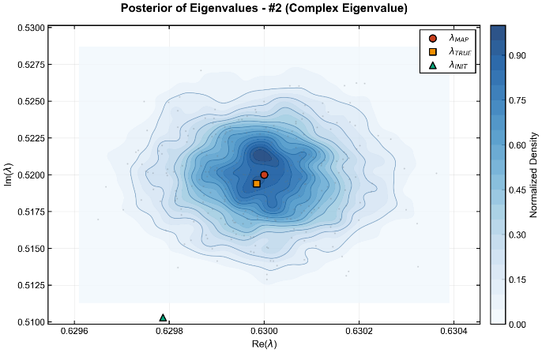
Background
Methodology
Results
Discussion
Conclusion
Para | Prior(Re) | Prior(Im) | Result(Re) | CV(Re) | Result(Im) | CV(Im)
 | uniform | uniform | 0.52 | 2.1% | / | /
 | uniform | uniform | 0.63 | 0.4% | +0.52i | 0.72%
 | uniform | uniform | 0.63-0.52i | 0.4% | -0.52i | 0.72%
 | N~(0.1,0.2) | / | 0.1200 | 3.61% | / | /
 | N~(0.15,0.2) | / | 0.1500 | 5.26% | / | /
 | N~(0.2,0.2) | / | 0.1999 | 6.74% | / | /

Slide 18
The Forth Section
Discussion

Slide 19
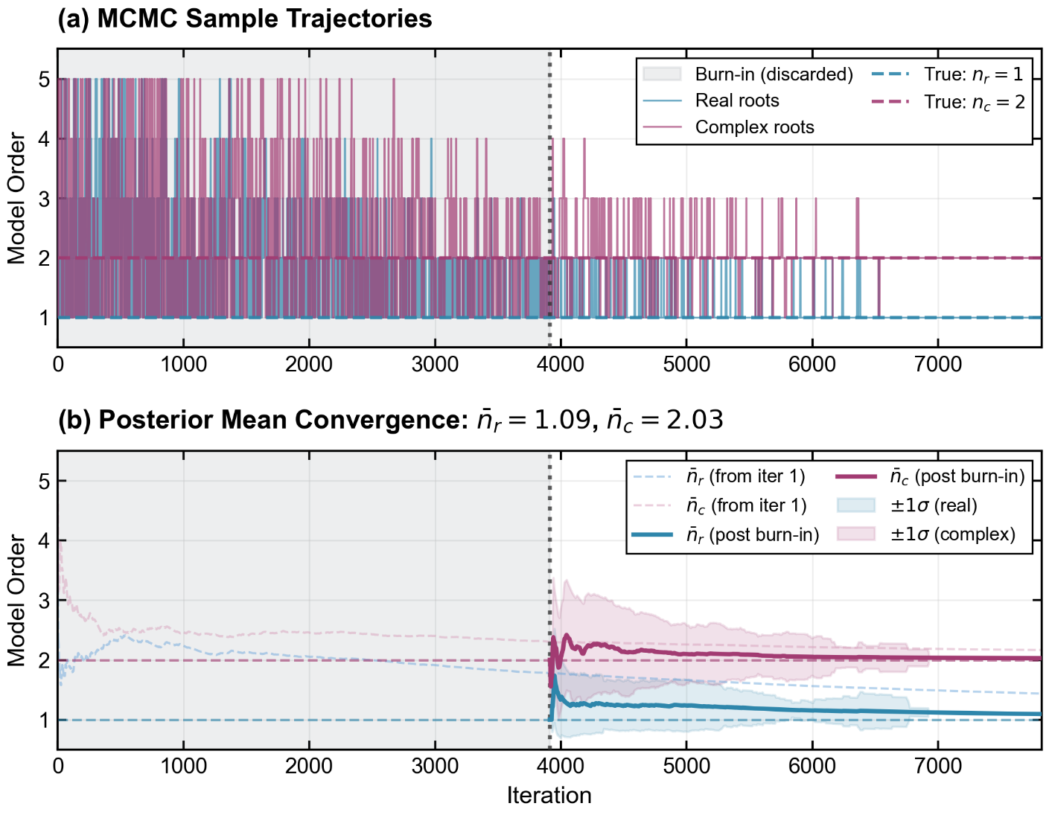
Background
Methodology
Results
Discussion
Conclusion
Analysis of the convergence process
After the burn-in process, the model order remains at 3, and its eigenvalues consist of one complex conjugate pair and one real value.
The system order converge because of the convergence of parameters, which is not as expected.

Slide 20

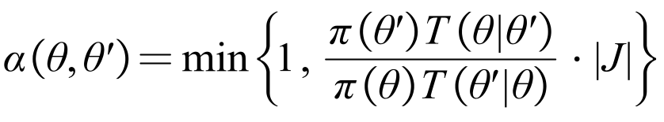
Background
Methodology
Results
Discussion
Conclusion
To determine whether to proceed with model order changes a BIC criterion is used:
Bayesian information criterion
The posterior of model order and parameter can be applied:
The acceptance ratio then can be determined:

Slide 21
The Forth Section
Conclusion

Slide 22
Background
Methodology
Results
Discussion
Conclusion
This work presents a unified identification framework based on the Reversible-Jump Markov Chain Monte Carlo (RJ-MCMC) algorithm for the joint estimation of system order and parameters in state-space models. The key contributions are threefold:
Joint Bayesian Inference: Our method provides a principled Bayesian solution to the challenging problem of simultaneously inferring the model dimension and its parameters, overcoming the limitations of traditional two-step approaches.
Reversible Model Transition: To facilitate flexible exploration of the model space, we designed five specialized moves that allow for the birth, death, and transformation of system poles, all while maintaining the detailed balance condition for valid sampling.
Automatic Order Control: The Bayesian Information Criterion is integrated into the MCMC acceptance ratio. This mechanism automatically penalizes unnecessary complexity, effectively preventing overfitting by controlling the system order.

